Slide 1
WELCOME

Slide 2
Uber Data Analysis And Visualization
Data Cleaning and Preprocessing
JSON Data Structuring
SQL Database Management
Data Visualization with Power BI/Tableau
Analytical Thinking and Problem Solving

Slide 3
Analytical Questions for Dashboard
What are the fare trends based on year, month, week, and day?
Which travel mode (Uber Go, Uber XUV, Uber Premium) is most popular?
What are the peak hours for Uber rides?
Which locations are the most frequently traveled?
What is the distribution of passenger counts across trips?
How do fare prices vary by travel mode?
What is the average trip distance per travel mode?
How does fare price vary by time of day?
What are the busiest locations on weekends versus weekdays?
What is the average fare for rides starting or ending at specific locations?

Slide 4
Technical Tags:
Data Cleaning
SQL
Power BI/Tableau
JSON Handling

Slide 5
Data Set Explanation:
The dataset contains Uber ride information, including:
Date and Time: Timestamps for ride start and end.
Fare Price: Cost of the ride.
Passenger Count: Number of passengers.
Locations: Latitude and longitude for pickup and dropoff.
Derived Columns: Includes travel_mode based on passenger count and price

Slide 6
Preprocessing Steps:
Normalize JSON data into tabular format.
Convert date/time columns into standard formats.
Handle missing and duplicate values.
Create derived columns such as travel_mode.

Slide 7
Lets Go The Project
Open the Json file data
Load to excel sheet
Clean the data
Convert to structure data

Slide 8
Power point visualization
Open the power point
Select the home page
Click to Excel workbook
Upload the excel data

Slide 9
Power point visualizations
Select the visualizations
And drag the data X axis Y axis basic
Show the visuals
Make a visuals as per given the questions basic

Slide 10
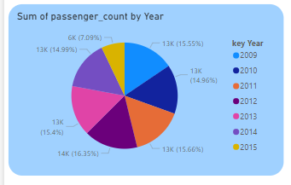
Sum of passenger count by year

Slide 11

Sum of fare amount / Sum of passenger count

Slide 12
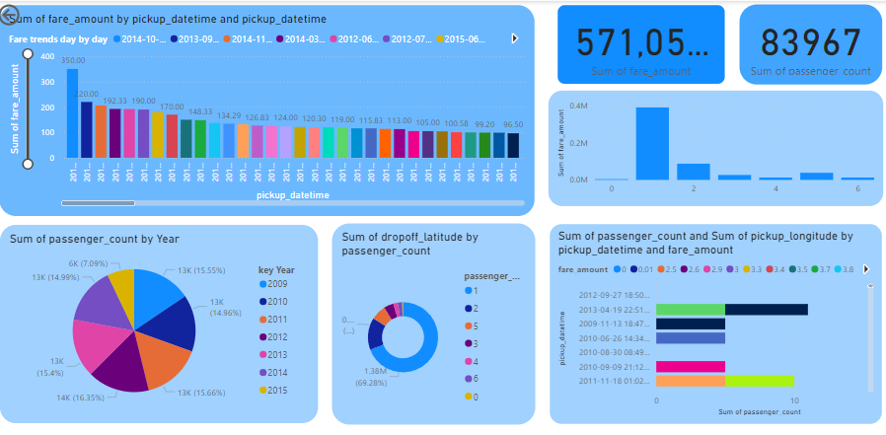
Final project output

Slide 13
Thank you

